Slide 1
Evaluating used car value in classified markets using supervised learning
By Vera Ebel

Slide 2


The wild world of used cars, and the constantly fluctuating prices therein
Notes:
Involves large variable sums
The product has a large number of variables that impact the price
Despite this, there’s surprisingly little set procedure as to how any particular attribute of a car will impact its price.
Case in point; my 2016 Nissan Versa
9000 miles
No damage to speak of

Slide 3
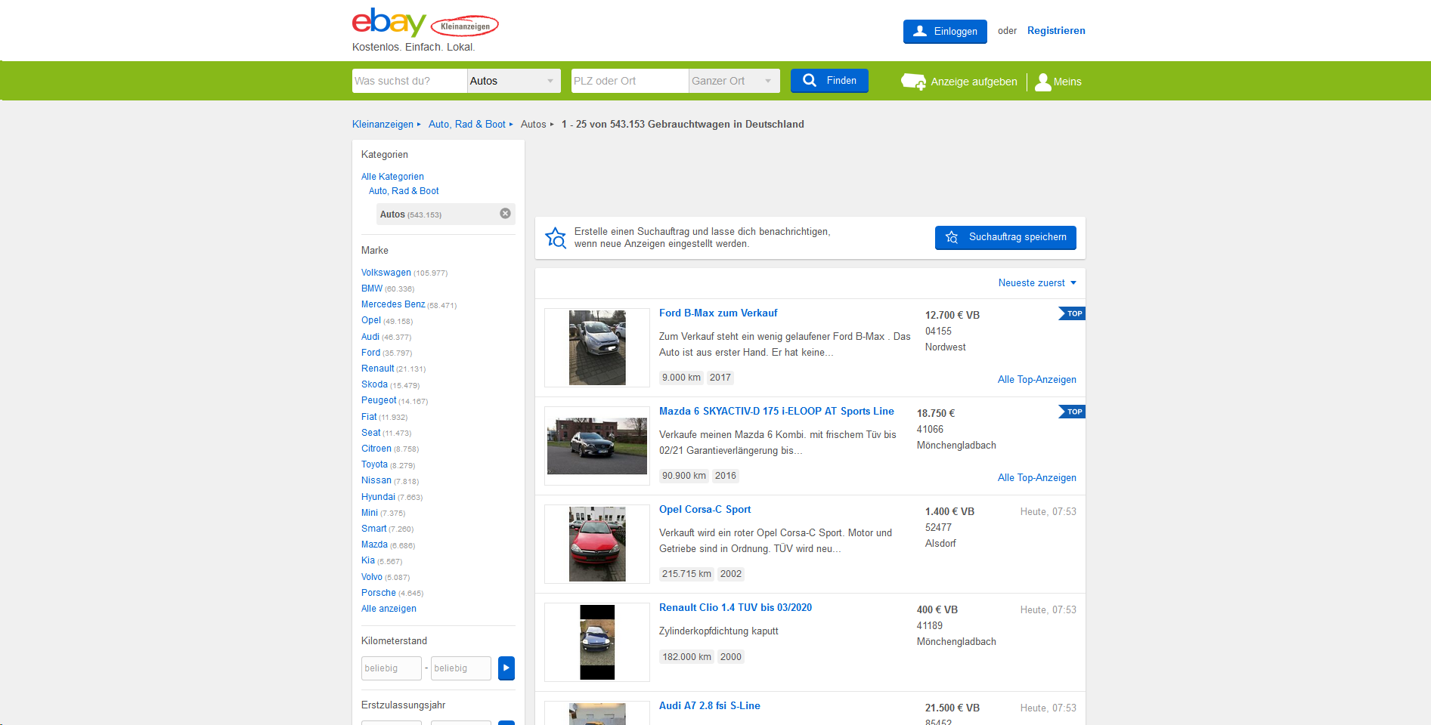
The data set
Notes:
The data was scraped from german automobile classifieds
A lot of cleaning and scraping was needed to make the data amenable to actual analysis.
As a result we lost valuable insights
The “seller” column was mostly one data point, “private” indicating the sellers name was private, there were a handful of “commercial” category sellers, but not enough to justify it’s inclusion in the data set.
Dates, while useful for engineering other features, were too varied to produce useful data
Zip codes were not consistent enough to use as a scalar value, and were too varied to use easily as a categorical one.
A similar issue came up with the names of the cars, when it came to regression.
The price is set from the sellers perspective, we do not know if a particular classified did find a successful buyer.
Many of these features could be integrated in a blackbox random forest regression.

Slide 4


Concerns that face a buyer and seller viewing a classified ad
Expected time frame of availability.
Appropriate pricing
Notes:
Length of time
A substantial amount of capital is locked up in a car for most sellers, giving them cause to liquify that asset as quickly as possible.
A buyer is always risking losing the best offer they see when they choose to not follow up on a classified ad. Knowing the probable remaining time left to the cars availability helps them quantify the risk.
Appropriate pricing
A car's value is fluctuating in reaction to several important features.
Damage, the number of kilometers logged, value of a model and its year.
Resale value at the dealership is not equivalent to resale value in classifieds.
Developing an aggregate estimation of what prices get posted is the best approach

Slide 5
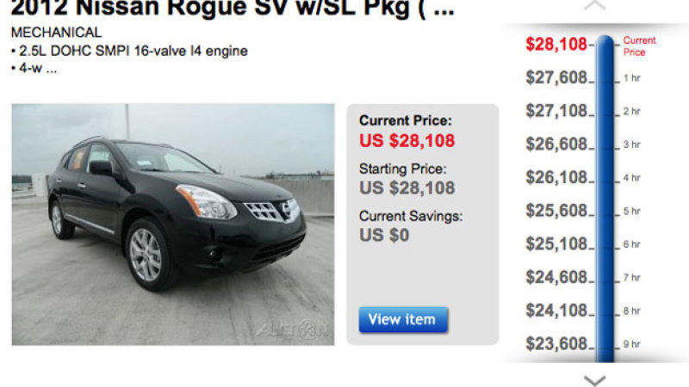
Framing the data from a sellers and buyers perspective
Notes:
While, statistically, we might be able to use features in models to alter prices in such a way that would be advantageous to the market, the nature of personal psychology limits what information can reasonably be interpreted in order to implement.
Case in point: Ebay Motors and AutoNation attempted and failed to implement a reverse auction model. Sellers found that they were unable to find that amount of bidders interested in a reverse auction to get the bid to close. With setting a minimum threshold, buyers often would lack the interest in their item to start the countdown, and would fail to close a bid. Without doing so, they were at risk at a substantial financial loss that they were unwilling to take.

Slide 6
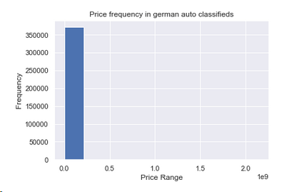
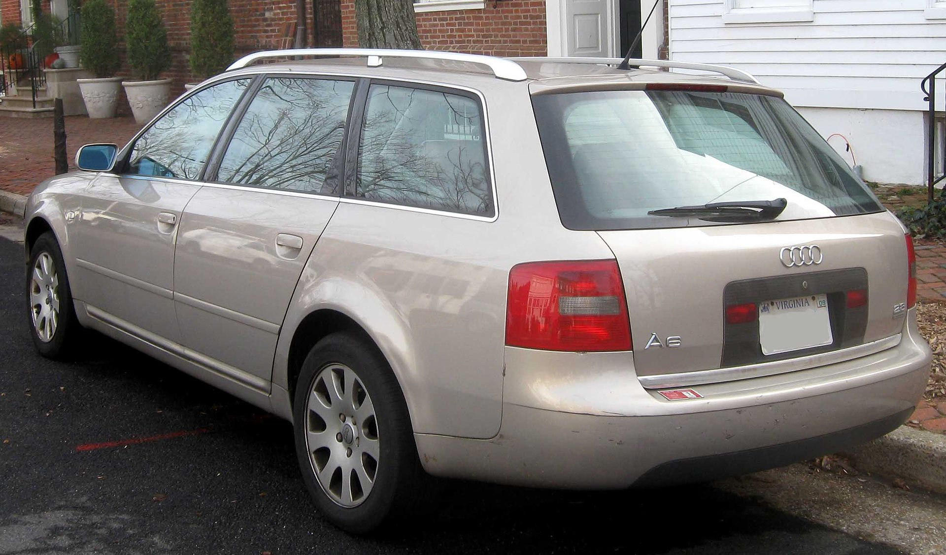
The perils of letting users define feature values
Mileage: 150000 Kilometers, Price: €99,999,999
Notes:
2147483647 max for price. Translated to “Make your own car” at 888 Horsepower.
This car is an audi a6 c5 avant, it along with 56 other cars was

Slide 7
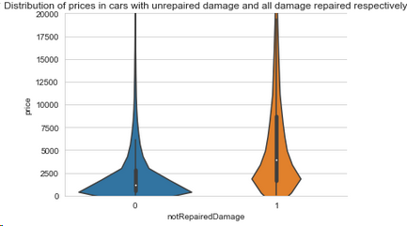
The other end...
Notes:
There were 5044 cars listed at $0. Representing nearly a 6th of the dataset.

Slide 8


The models
Notes:
Both regression and classification can be valuable.
Although a user will want to have a prediction for the exact value and wait for their classified car ad, they would likely prefer a more accurate bracket that the car was classified under.
If accurate regression is possible with the data, then that’s what should be presented to the userbase.
If it is impossible, but classification is possible, then that’s the form of model that should be shown to the user base.

Slide 9
Not all output variables are easy to predict
Price was the easiest output variable to fit a regression to. It scored at .87 R2 value, accurate enough to provide some meaningful insight to a person uncertain of the value of the car that they’ve posted.
Time was much more difficult. Despite the abundance of data available, it seemed like there was less consistency between it and the other features. An important detail is that we do not have info on the end state of the car. Simply the time it was last seen by the crawler before being removed. In short, either we had missing data that prevented it from being accurately predicted, or there’s simply an element of bad luck to how long a classified will remain up.

Slide 10
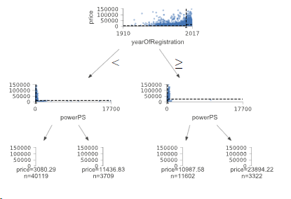
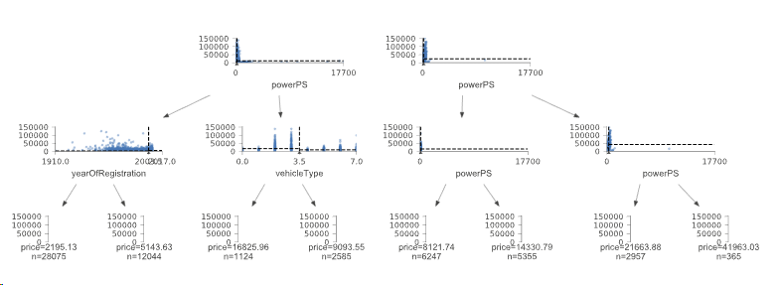
Assessing price

Slide 11


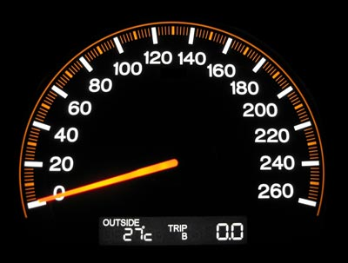
What matters for the price model?
Notes:
Vehicle type, registration year and month, horsepower and brand were massively important.

Slide 12


What didn’t matter for the price model?
However, these did matter in the prediction for if a classified ad was going to stay up for a substantial amount of time.
Notes:
Mileage, damage,

Slide 13
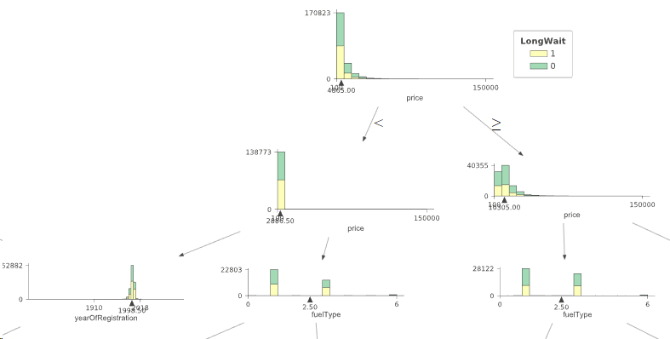
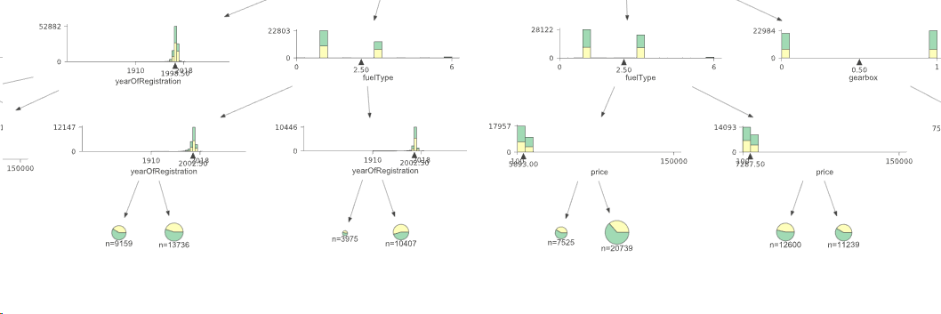
Assessing time

Slide 14
Conclusion
Used cars have a multitude of features which have a cumulative effect on it’s value
However, sellers generally pay the most attention to features that determined the value of the car when they bought it, and tend to underestimate the depreciation in value that has occured while the car was in their possession.
It is easy to post a car at a reasonable price, but difficult to know when it will be responded to
Price represents a seller mindset, which comes with it’s own biases, the time in which it takes the car to sell represents a buyers concern, the discrepancy between these two in terms of feature importance represents a difficulty private sellers have in evaluating their own car.

Slide 15
Links and sources
The data: https://www.kaggle.com/orgesleka/used-cars-database
The module used for decision tree visualizations: https://github.com/parrt/dtreeviz
Jupyter notebook: https://drive.google.com/file/d/1u0ri-WWqetcE_Wf_5EGqaPGcDgKFQ8L2/view?usp=sharing

